Slide 1
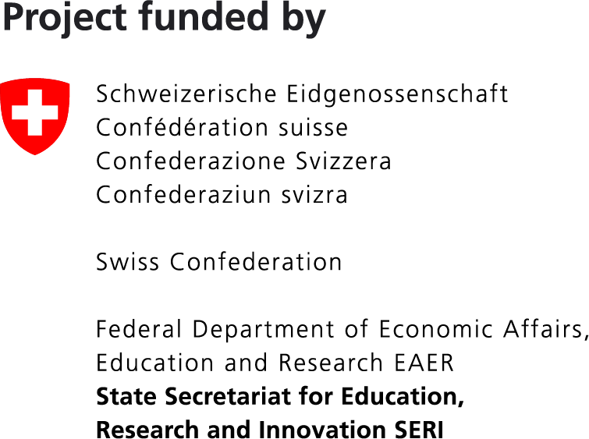
ID-DarkMatter-NCD
Unraveling the dark matter of infectious diseases, environmental and genetic factors tipping the balance towards NCDs.
HORIZON-HLTH-2023-DISEASE-03-07
Notes:
Explain that meeting over the next 2 days, but first public part to enable collaboraitons

Slide 2
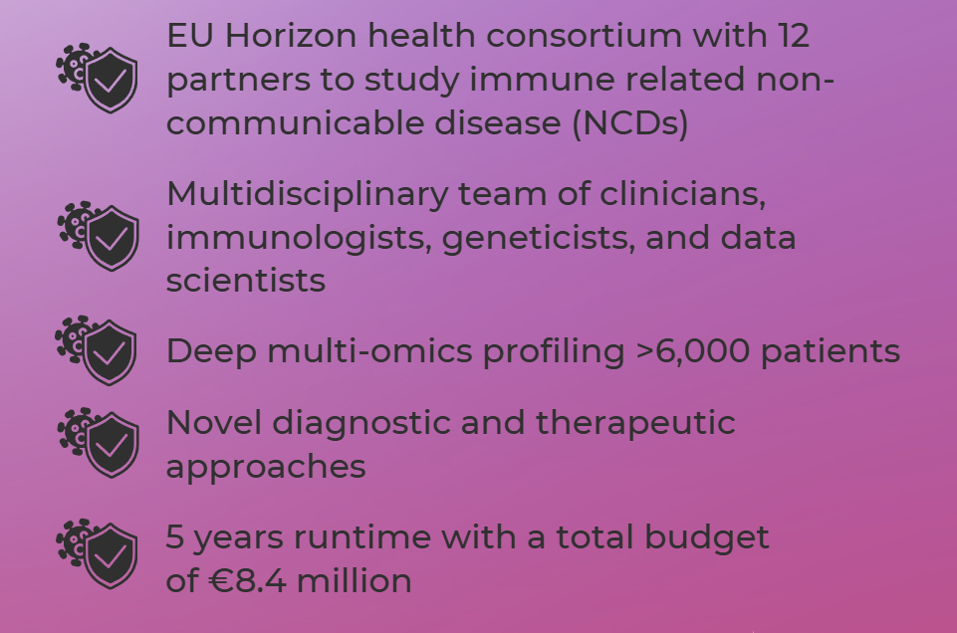
ID-DarkMatter-NCD
Infectious Diseases
Non-Communicable Diseases
Notes:
SERI Funding: 1’255’045 CHF

Slide 3
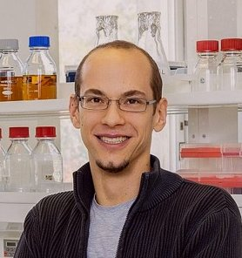
Our Consortium Partners
Medical University of Vienna (AUT)
Karolinska Institute (SE)
Sorbonne University (FR)
Vogl, 2021 Nature medicine
Bonelli, 2022, Nature communications
2023, Immunity
2023, Immunity
2021, Immunity
2016, Nature medicine
Vogl (coordinator)
Bonelli
Karlsson Hedestam
Sokol
University of Basel (CH)
UKSH (Kiel, DE)
BRC (Szeged, HR)
VHIR (Barcelona, ES)
2020, Science Immunology
2016, The New England Journal of Medicine
2018, Annals of the rheumatic diseases
2021, Nature genetics
2021, PNAS
2021, Nature Cancer
Pröbstel
Franke
Manczinger
Julia
Leiden University Medical Center (NL)
University Medical Center Groningen (NL)
Eutema (Vienna AUT)
2015, Nature communications
2010, Nature genetics
2022, The Lancet
2022, Nature
2016, Science
van der Woude
Rosmalen
Weersma
Zhernakova
Melzer

Slide 4
Project Title and Aim
Understanding Infectious Diseases
This project aims to explore how infectious diseases contribute to the development of non-communicable diseases (NCDs).
Environmental Factors
Environmental factors play a crucial role in tipping the balance towards NCDs, influencing overall health outcomes.
Genetic Contributions
Genetic predispositions may also impact the likelihood of developing non-communicable diseases, making this an area of focus.
Notes:
--- This slide references information from the following file: https://eutemaresearch-my.sharepoint.com/personal/fresolone_eutema-research_eu/_layouts/15/Doc.aspx?sourcedoc=%7B97C91BD9-09BE-40F0-BE67-C59F6C8744B3%7D&file=ID-DM-NCD_2023-04-12%20noon%20safety%20version%20%20Merged%20(Tpl_Application%20Form%20(Part%20B)%20(HE%20RIA%20and%20IA))%20-%20Copy.docx&action=default&mobileredirect=true&DefaultItemOpen=1 ID-DarkMatter-NCD Unraveling the dark matter of infectious diseases, environmental and genetic factors tipping the balance towards NCDs

Slide 5
Introduction to IR-NCDs
Overview of IR-NCDs
IR-NCDs include diseases like multiple sclerosis, rheumatoid arthritis, and post-COVID-19 condition, affecting millions globally.
Impact on Healthcare Systems
The annual cost of IR-NCDs is approximately 2.4 trillion €, posing a significant burden on healthcare systems worldwide.
Triggers and Associations
Infectious diseases can trigger IR-NCDs, but the biological mechanisms and specific triggers remain largely unexplored.
Genetic and Environmental Factors
Genetic and environmental aspects influence the development of IR-NCDs, but exact factors are unknown for most conditions.
Notes:
--- This slide references information from the following file: https://eutemaresearch-my.sharepoint.com/personal/fresolone_eutema-research_eu/_layouts/15/Doc.aspx?sourcedoc=%7B97C91BD9-09BE-40F0-BE67-C59F6C8744B3%7D&file=ID-DM-NCD_2023-04-12%20noon%20safety%20version%20%20Merged%20(Tpl_Application%20Form%20(Part%20B)%20(HE%20RIA%20and%20IA))%20-%20Copy.docx&action=default&mobileredirect=true&DefaultItemOpen=1 Immune-related noncommunicable diseases (IR-NCDs) are characterized by autoimmune or inflammatory phenotypes, and include diseases such as post-COVID-19 condition (PCC), multiple sclerosis (MS), myalgic encephalomyelitis/chronic fatigue syndrome (ME/CFS), rheumatoid arthritis (RA), systemic lupus erythematosus (SLE), and inflammatory bowel disease (IBD). Worldwide, hundred millions of individuals are affected by these six IR-NCDs, dozens of millions of whom live in Europe. Conservative estimates of the total cost (treatments, loss of income etc.) for these IR-NCDs range around 2.4 trillion € per year, representing a huge burden to the healthcare system. In recent years, it has been appreciated that infectious diseases (IDs) can trigger IR-NCDs. For example, PCC is caused by SARS-CoV-2 infection, and a role of Epstein-Barr virus (EBV) in MS has been implied. For most other IR-NCDs, no such triggers are known (yet), though roles of IDs have been suggested by epidemiological studies. Yet, these findings are inconsistent and a biological understanding of these associations is missing. One of the challenges for identification of a direct link between IDs and IR-NCDs is that microbes causing IDs have large genomes with hundreds of thousands of antigenic structures that could be implicated in IR-NCD onset. However, given limitations in the throughput of conventional methods to detect all of these structures in parallel, this vast space of potential ID triggers remains unexplored, representing the dark matter of ID-immune interactions. Furthermore, in the great majority of cases, exposure to an ID alone does not trigger development of an IR-NCD. For example, only a subset of patients infected with SARS-CoV-2 develop PCC. Hence, genetic and environmental aspects also affect the likelihood of developing IR-NCDs, but the exact factors are unknown for most IR-NCDs.

Slide 6
Infectious Diseases and IR-NCDs
Link Between IDs and IR-NCDs
Infectious diseases can trigger immune-related non-communicable diseases, but the mechanisms are not fully understood.
Dark Matter of ID Interactions
The vast array of antigenic structures in microbes complicates understanding how IDs lead to IR-NCDs.
Environmental and Genetic Factors
Genetic and environmental factors influence the likelihood of developing IR-NCDs after ID exposure.
Clinical Cohorts for Research
Using longitudinal data from large cohorts to study pre-diagnostic markers of disease onset is crucial.
Notes:
--- This slide references information from the following file: https://eutemaresearch-my.sharepoint.com/personal/fresolone_eutema-research_eu/_layouts/15/Doc.aspx?sourcedoc=%7B97C91BD9-09BE-40F0-BE67-C59F6C8744B3%7D&file=ID-DM-NCD_2023-04-12%20noon%20safety%20version%20%20Merged%20(Tpl_Application%20Form%20(Part%20B)%20(HE%20RIA%20and%20IA))%20-%20Copy.docx&action=default&mobileredirect=true&DefaultItemOpen=1 In recent years, it has been appreciated that infectious diseases (IDs) can trigger IR-NCDs. For example, PCC is caused by SARS-CoV-2 infection, and a role of Epstein-Barr virus (EBV) in MS has been implied. For most other IR-NCDs, no such triggers are known (yet), though roles of IDs have been suggested by epidemiological studies. Yet, these findings are inconsistent and a biological understanding of these associations is missing. One of the challenges for identification of a direct link between IDs and IR-NCDs is that microbes causing IDs have large genomes with hundreds of thousands of antigenic structures that could be implicated in IR-NCD onset. However, given limitations in the throughput of conventional methods to detect all of these structures in parallel, this vast space of potential ID triggers remains unexplored, representing the dark matter of ID-immune interactions. Furthermore, in the great majority of cases, exposure to an ID alone does not trigger development of an IR-NCD. For example, only a subset of patients infected with SARS-CoV-2 develop PCC. Hence, genetic and environmental aspects also affect the likelihood of developing IR-NCDs, but the exact factors are unknown for most IR-NCDs. Here, we aim to 1.) identify IDs triggering IR-NCDs, and 2.) to disentangle environmental and genetic factors affecting the transition from IDs to IR-NCDs by combining multi-omics approaches and novel technologies for personalized genotyping of adaptive immune receptor genes. We will focus on representative IR-NCDs where well-characterized patient cohorts are available from the partners. A key limitation in conventional clinical studies is that any events that occurred before diagnosis and enrollment in the healthcare system cannot be assessed. Thereby the initial cause and potential ID triggers can only be studied retrospectively. We will solve this problem by using both a.) clinical cohorts and b.) a population scale cohort (“LifeLines”). In Lifelines, samples from >150,000 healthy individuals were collected longitudinally for >15 years. Over time, some individuals have developed IR-NCDs that were recorded in follow ups. In ID-DarkMatter-NCD, we access these patients’ samples before disease onset to identify pre-diagnostic markers of subclinical differences preceding and predicting disease onset.

Slide 7
Main Objectives
Identifying ID Triggers
We aim to identify infectious diseases (IDs) that trigger immune-related non-communicable diseases (IR-NCDs) through innovative research methods.
Environmental and Genetic Factors
The study will disentangle environmental and genetic factors affecting the transition from IDs to IR-NCDs using multi-omics approaches.
Longitudinal Patient Profiling
We will profile over 6,000 patients longitudinally to identify biomarkers and disease mechanisms of various IR-NCDs.
Innovative Research Technologies
Utilizing state-of-the-art technologies such as PhIP-Seq to characterize immune responses and study previous environmental exposures.
Notes:
--- This slide references information from the following file: https://eutemaresearch-my.sharepoint.com/personal/fresolone_eutema-research_eu/_layouts/15/Doc.aspx?sourcedoc=%7B97C91BD9-09BE-40F0-BE67-C59F6C8744B3%7D&file=ID-DM-NCD_2023-04-12%20noon%20safety%20version%20%20Merged%20(Tpl_Application%20Form%20(Part%20B)%20(HE%20RIA%20and%20IA))%20-%20Copy.docx&action=default&mobileredirect=true&DefaultItemOpen=1 Here, we aim to 1.) identify IDs triggering IR-NCDs, and 2.) to disentangle environmental and genetic factors affecting the transition from IDs to IR-NCDs by combining multi-omics approaches and novel technologies for personalized genotyping of adaptive immune receptor genes. We will focus on representative IR-NCDs where well-characterized patient cohorts are available from the partners. A key limitation in conventional clinical studies is that any events that occurred before diagnosis and enrollment in the healthcare system cannot be assessed. Thereby the initial cause and potential ID triggers can only be studied retrospectively. We will solve this problem by using both a.) clinical cohorts and b.) a population scale cohort (“LifeLines”). In Lifelines, samples from >150,000 healthy individuals were collected longitudinally for >15 years. Over time, some individuals have developed IR-NCDs that were recorded in follow ups. In ID-DarkMatter-NCD, we access these patients’ samples before disease onset to identify pre-diagnostic markers of subclinical differences preceding and predicting disease onset. Overall, we will deeply profile >6,000 patients of six IR-NCDs (PCC, MS, ME/CFS, IBD, RA, SLE) by generating multiple layers of immune system, genetics, and microbiota data to identify novel biomarkers and disease mechanisms. We will leverage state-of-the-art approaches such as phage-display immunoprecipitation sequencing (PhIP-Seq) to characterize humoral and B cellular immune responses, as well as orthogonal approaches covering T-cells. ID & environmental exposures will be analyzed by microbiota metagenomics sequencing, as well as PhIP-Seq libraries of 600,000 bacterial/viral antigens to study immunological memory & the role of previous exposures.

Slide 8
Specific Objectives
Identification of IDs
Determine which infectious agents are associated with the onset of various immune-related non-communicable diseases (IR-NCDs).
Role of Pathobionts
Investigate how certain pathobionts can trigger IR-NCDs, similar to infectious diseases.
Impact on Treatment
Explore how specific IDs or pathobionts can exacerbate existing IR-NCDs and influence treatment efficacy.
Notes:
--- This slide references information from the following file: https://eutemaresearch-my.sharepoint.com/personal/fresolone_eutema-research_eu/_layouts/15/Doc.aspx?sourcedoc=%7B97C91BD9-09BE-40F0-BE67-C59F6C8744B3%7D&file=ID-DM-NCD_2023-04-12%20noon%20safety%20version%20%20Merged%20(Tpl_Application%20Form%20(Part%20B)%20(HE%20RIA%20and%20IA))%20-%20Copy.docx&action=default&mobileredirect=true&DefaultItemOpen=1 Objective 1: Identify ID/pathobiont triggers of IR-NCDs Which IDs (bacteria or viruses) associate with the onset of different IR-NCDs? Which pathobionts act as trigger of IR-NCDs, similar to the role of IDs? Which IDs or pathobionts worsen existing IR-NCDs and affect the response to treatment?

Slide 9
Multi-Omics Approach
Multi-Disease Analysis
We will investigate six IR-NCDs to understand their interconnections and common triggers for diseases.
Multi-Cohort Study
Enrolling patients from various studies and countries to gather a diverse data set for analysis.
Advanced Technologies
Utilizing novel technologies and extensive libraries of antigens for studying infectious disease exposure links to IR-NCDs.
Comprehensive Profiling
Deep profiling of over 6,000 patients to discover novel biomarkers and disease mechanisms for IR-NCDs.
Notes:
--- This slide references information from the following file: https://eutemaresearch-my.sharepoint.com/personal/fresolone_eutema-research_eu/_layouts/15/Doc.aspx?sourcedoc=%7B97C91BD9-09BE-40F0-BE67-C59F6C8744B3%7D&file=ID-DM-NCD_2023-04-12%20noon%20safety%20version%20%20Merged%20(Tpl_Application%20Form%20(Part%20B)%20(HE%20RIA%20and%20IA))%20-%20Copy.docx&action=default&mobileredirect=true&DefaultItemOpen=1 Here, we will apply a 1. multi-disease (six IR-NCDs: PCC, MS, ME/CFS, RA, SLE, IBD), 2. multi-cohort (enrolling patients from different studies and countries), and 3. multi-omics approach (IDs/pathobionts vs. immune system, genetics, environment) to identify IDs triggering IR-NCDs, and to disentangle environmental and genetic factors affecting the transition from IDs to IR-NCDs. Hence, we will overcome conventional studies by systematically studying multiple factors in multiple diseases. For studying exposures to IDs/pathobionts, we will leverage a novel technology and libraries of 600,000 bacterial/viral antigens (as well as human proteins, section 1.2.1.2, WP1-T4) to test for previous ID exposures associated with IR-NCD onset and potential molecular mimicry. Regarding patients cohort, conventional clinical studies miss any events that occurred before diagnosis and enrollment in the healthcare system. Thereby the initial cause and potential ID triggers can only be studied retrospectively. We will solve this problem by using both clinical cohorts and a population scale cohort (“LifeLines”). In Lifelines, samples from >150,000 healthy individuals were collected and stored longitudinally for >15 years. Over time, some individuals have developed IR-NCDs that were recorded in follow ups. In ID-DarkMatter-NCD, we access these patients’ samples before disease onset to identify pre-diagnostic markers of subclinical differences preceding and predicting disease onset. We will deeply profile in total >6,000 patients of the six IR-NCDs by generating multiple layers of immune system, microbiota, host genetics data to mine for novel biomarkers and disease mechanisms (WP1). We will leverage state of the art (SotA) approaches such as phage display immunoprecipitation sequencing (PhIP-Seq) to cover humoral immunity (WP1-T3), as well as orthogonal approaches covering T cells (WP4-T4). Environmental exposures will be covered by microbiota metagenomics shotgun sequencing (WP1-T3), as well as PhIP-Seq libraries of 600,000 bacterial and viral antigens allowing to study immunological memory and the role of previous exposures. Furthermore, we will also study the exposome and symptomics by metagenomics, metabolomics (WP1-T5), as well as questionnaires that the patients have filled out, and electronic health records (EHRs) providing information on disease development, response to treatment etc. (detailed in section 1.2.1.2, WP1-T1).

Slide 10
Genetic Analysis
Whole Genome Sequencing
We will utilize whole genome sequencing data to investigate genetic variations that influence immune responses.
Genotyping Methods
Proprietary high throughput genotyping methods will focus on critical polymorphisms related to immunity.
Multi-Omics Approach
A multi-disease, multi-cohort, multi-omics strategy will yield new insights for various immune-related non-communicable diseases.
Notes:
--- This slide references information from the following file: https://eutemaresearch-my.sharepoint.com/personal/fresolone_eutema-research_eu/_layouts/15/Doc.aspx?sourcedoc=%7B97C91BD9-09BE-40F0-BE67-C59F6C8744B3%7D&file=ID-DM-NCD_2023-04-12%20noon%20safety%20version%20%20Merged%20(Tpl_Application%20Form%20(Part%20B)%20(HE%20RIA%20and%20IA))%20-%20Copy.docx&action=default&mobileredirect=true&DefaultItemOpen=1 Regarding genetic factors, we will leverage whole genome sequencing (WGS) data alongside proprietary high throughput genotyping methods to focus on HLA, IGV, and TCR polymorphisms (WP2-T1-3). Mounting data of recent years has implied these loci in shaping immune responses, and by combining functional PhIP-Seq data with genetic variation will shed light on their role in IR-NCDs. Thereby, ID-DarkMatter-NCD will represent the largest and most deely profiled systematic study of multiple IR-NCDs. Our multi disease, multi-cohort, multi-omics approach will generate new insights for each single disease studied (WP3-5). Eventually these multilayered datasets of every disease will be combined allowing for comparative analyses (WP6) that will provide insights on shared mechanisms and differences in different IR-NCDs, with the key objectives outlined below (also summarized in Tab 1.1 on page 7).

Slide 11
Expected Outcomes

Slide 12
Scientific Outcomes
Identifying Novel Associations
Our research will uncover previously unknown associations between IDs and IR-NCDs using advanced multi-omics technologies.
Establishing Causality
Causality will be demonstrated through longitudinal studies and mechanistic in vitro and in vivo experiments, focusing on specific diseases.
Exploring Trigger Factors
We aim to identify modulating factors and potential triggers for IR-NCDs, particularly through thorough immunomics research.
Notes:
--- This slide references information from the following file: https://eutemaresearch-my.sharepoint.com/personal/fresolone_eutema-research_eu/_layouts/15/Doc.aspx?sourcedoc=%7B97C91BD9-09BE-40F0-BE67-C59F6C8744B3%7D&file=ID-DM-NCD_2023-04-12%20noon%20safety%20version%20%20Merged%20(Tpl_Application%20Form%20(Part%20B)%20(HE%20RIA%20and%20IA))%20-%20Copy.docx&action=default&mobileredirect=true&DefaultItemOpen=1 (a) Better understanding of the causalities between IDs and IR-NCDs including knowledge on host risk factors. By using our proprietary multi-omics technologies alongside large patient cohorts, we will identify novel associations between IDs and IR-NCDs (as already demonstrated in proof-of-concept work in ME/CFS6 and IBD5). These associations will be identified in WP3/4/5-T1 for the three disease subgroups (neurological, rheumatic diseases, IBD). Causality (beyond associations) will be established by leveraging longitudinal population scale cohorts (section 1.2.1, Tab. 1), mouse models (WP3/4/5-T4), and mechanistic in vitro/ex vivo studies (WP3/4/5-T4) resulting in the following outcomes: · Scientific: By applying a multi-omics approach (WPs1,2), including immunomics against 600,000 antigens of IDs and pathobionts (WP1-T4), we will identify previously unknown associations to IDs in IR-NCDs, as well as modulating factors of known triggers: For the six IR-NCDs tested, in two of them (PCC, MS) the triggers are known (SARS-CoV-2, MS), but for the others (IBD, RA, SLE, ME/CFS) triggering IDs are rather speculative and not confirmed by population scale studies. As our proof-of-concept work screening for potential triggers in IBD and ME/CFS was highly promising 5,6, there is a high likelihood that we will find triggers in all 4 diseases. For demonstrating causation, we will start with flagellins in ME/CFS, IBD (WP3,5-T4) and add novel targets to test in mouse models as the human cohorts are more extensively profiled (WP3,4-T4, MS3.2).

Slide 13
Economic and Technological Outcomes
Biomarker Development
High throughput screenings will identify biomarkers for various diseases, enabling targeted diagnostics and treatments.
Diagnostic Kit Preparation
We will prepare and validate ELISA kits that can be used in molecular diagnostics and the pharmaceutical industry.
Societal Impact
Creating diagnostic kits will enhance the speed of diagnosis, significantly reducing healthcare costs and benefiting society.
Notes:
--- This slide references information from the following file: https://eutemaresearch-my.sharepoint.com/personal/fresolone_eutema-research_eu/_layouts/15/Doc.aspx?sourcedoc=%7B97C91BD9-09BE-40F0-BE67-C59F6C8744B3%7D&file=ID-DM-NCD_2023-04-12%20noon%20safety%20version%20%20Merged%20(Tpl_Application%20Form%20(Part%20B)%20(HE%20RIA%20and%20IA))%20-%20Copy.docx&action=default&mobileredirect=true&DefaultItemOpen=1 · Economic/technological: The high throughput screenings will yield biomarkers, that can be cut down to predictive key epitopes (expected 5-10 per disease), that can be tested for in conventional ELISAs. We will prepare and validate conventional ELISA kits (WP6-T3,4), that can then be leveraged by molecular diagnostics laboratories (applying our kits) and the pharmaceutical industry (producing these kits and following up on therapeutic approaches, milestones 6.1 and 6.2). · Societal: Providing clinicians and the healthcare system with novel links between IDs and IR-NCDs (and by creating diagnostic kits to test for these triggers) will speed up diagnosis, saving time and reducing costs for these highly cost-intensive diseases (benefiting the entire society by alleviating health care cost, section 2.1b).

Slide 14
Impact

Slide 15
Impact on Healthcare
Benefits for Patients
Patients and their families will benefit from improved diagnostics and personalized predictions, enhancing treatment responses.
Enhanced Practitioner Insights
Healthcare practitioners will gain a deeper understanding of disease factors, allowing for better patient monitoring and care.
Molecular Diagnostics Labs
Molecular diagnostics laboratories will utilize new diagnostic tests, enhancing the healthcare chain's effectiveness.
Pharmaceutical Innovations
Pharmaceutical companies will develop new therapies and preventive vaccinations, contributing to overall healthcare advancements.
Notes:
--- This slide references information from the following file: https://eutemaresearch-my.sharepoint.com/personal/fresolone_eutema-research_eu/_layouts/15/Doc.aspx?sourcedoc=%7B97C91BD9-09BE-40F0-BE67-C59F6C8744B3%7D&file=ID-DM-NCD_2023-04-12%20noon%20safety%20version%20%20Merged%20(Tpl_Application%20Form%20(Part%20B)%20(HE%20RIA%20and%20IA))%20-%20Copy.docx&action=default&mobileredirect=true&DefaultItemOpen=1 The findings of ID-DarkMatter-NCD will be relevant to all entities involved along the healthcare care chain, representing the target groups of our project (as outlined in Fig. 7 and Tab. 2.3): On the one hand patients, their families, and also individuals at risk of developing these IR-NCDs (=potential future patients) will benefit from improved diagnostics and personalized prediction of disease progression and response to treatment. Also, healthcare practitioners (specialized clinicians as well as general practitioners, GPs) diagnosing and treating the patients will be able to provide better care by understanding the underlying disease factors, and can screen for individuals at risk and monitor them more closely. On the other hand, also the more “hands on” players along the health care chain will take advantage, as molecular diagnostics laboratories can run the novel diagnostic and genetic tests. Likewise, pharmaceutical companies will contribute to producing these kits (mid-term outcome) and develop therapies and preventive vaccination (longer term impact). Ultimately, the entire system of healthcare providers, public health authorities will take advantage from faster diagnosis and the general public (tax payers) will benefit from reduced cost for treatments. These aims and anticipated results match well with the outcomes and impacts expected for this call and the wider framework of tackling diseases to reduce disease burden, as detailed below: Outcomes specified for the topic of the relationships between infections and NCDs

Slide 16
Long-Term Impacts
Novel Therapies Development
Developing personalized treatments based on disease markers can significantly enhance patient outcomes in IR-NCDs.
Preventive Approaches
Vaccinations targeting infectious disease triggers could potentially eradicate certain IR-NCDs in the long term.
Multi-Omics Framework
Applying a multi-omics approach will provide insights into the aetiology of various IR-NCDs, benefiting diagnostics.
Notes:
--- This slide references information from the following file: https://eutemaresearch-my.sharepoint.com/personal/fresolone_eutema-research_eu/_layouts/15/Doc.aspx?sourcedoc=%7B97C91BD9-09BE-40F0-BE67-C59F6C8744B3%7D&file=ID-DM-NCD_2023-04-12%20noon%20safety%20version%20%20Merged%20(Tpl_Application%20Form%20(Part%20B)%20(HE%20RIA%20and%20IA))%20-%20Copy.docx&action=default&mobileredirect=true&DefaultItemOpen=1 · Novel therapies for patients suffering from the 6 IR-NCDs will facilitate treatment. Building on the ID/IR-NCDs links identified in the project, novel therapies will be developed and applied in a personalized fashion based on the markers identified (e.g. only patients in an advanced state of diseases, or right at onset may benefit from a certain therapy). Preventive approaches include the development of vaccinations against the ID triggers identified. Following these pathways, in the long run, some IR-NCDs may be eradicated (for example vaccinating individuals at risk of developing MS against EBV has been contemplated1, and could be a feasible pathway for all IR-NCDs once the triggers are known). Therapeutic approaches towards environmental factors as the microbiome would include novel probiotics to specifically block niches for IR-NCD associated pathobionts 5,6 and FMTs to modify and restore a healthy microbiome. Furthermore, also tolerance may be induced towards harmless factors targeted by misguided antibodies by immunotherapy (as done for allergies) via IgG4 s (that could either be produce as mAbs as short-term treatment, or therapy with antigens over longer time to induce these Igs). Other critical environmental factors such as medications, smoking etc. can be addressed by revised medial guidelines, and broadly targeted by information campaigns aimed at the general public. These approaches are equally relevant to patients and their families, clinicians treating them, partnering pharmaceutical industry developing such therapies (through clinical trials, which is not possible at universities on their own), and the general public (in the form of cost reduction for these expensive diseases). · Broader application of our multi-omics/cohort approach for the many other IR-NCDs with a potential involvement of ID triggers: A direct outcome of this project will be a framework/pipeline that can be applied to any IR-NCD entity (WP6-T5). Applying this pipeline will be an impact: Given the many other IR-NCDs with a potential involvement of ID triggers, (e.g. Alzheimer, Parkinson’s disease), this approach will shed light on the aetiology on many IR-NCDs, laying a foundation for generalizable pathways towards improved diagnostics and treatments, benefiting patients, clinicians, and pharmaceutical companies.

Slide 17
Conclusion
Understanding Disease Interplay
The ID-DarkMatter-NCD project aims to explore the connections between infectious and non-communicable diseases.
Collaborative Approach
Our team collaborates across disciplines to create effective public health strategies that address these complex health issues.
Impactful Outcomes
The project's findings are expected to lead to improved health outcomes and inform future public health policies.
Notes:
In conclusion, the ID-DarkMatter-NCD project represents a significant effort to understand the complex interplay between infectious and non-communicable diseases. Our collaborative approach aims to yield impactful outcomes that can inform public health strategies and improve health outcomes. Thank you for your attention.

